Slide 1
Problem statement
In digital communication systems, the following key problems motivate this project:
Data corruption occurs due to noise and electromagnetic interference in transmission channels.
Simple parity methods can only detect errors but cannot locate or correct them.
More complex ECC schemes exist but introduce significant hardware overhead.
There is a need for a system that balances error correction capability, hardware complexity, and processing speed — particularly for FPGA deployment.

Slide 2
objectives
To understand the basic concept of Hamming Code.
To learn how errors occur during data transmission.
To study the role of parity bits in error detection.
To understand how single-bit errors can be corrected using Hamming Code.
To analyze the importance of error detection and correction in digital communication systems

Slide 3
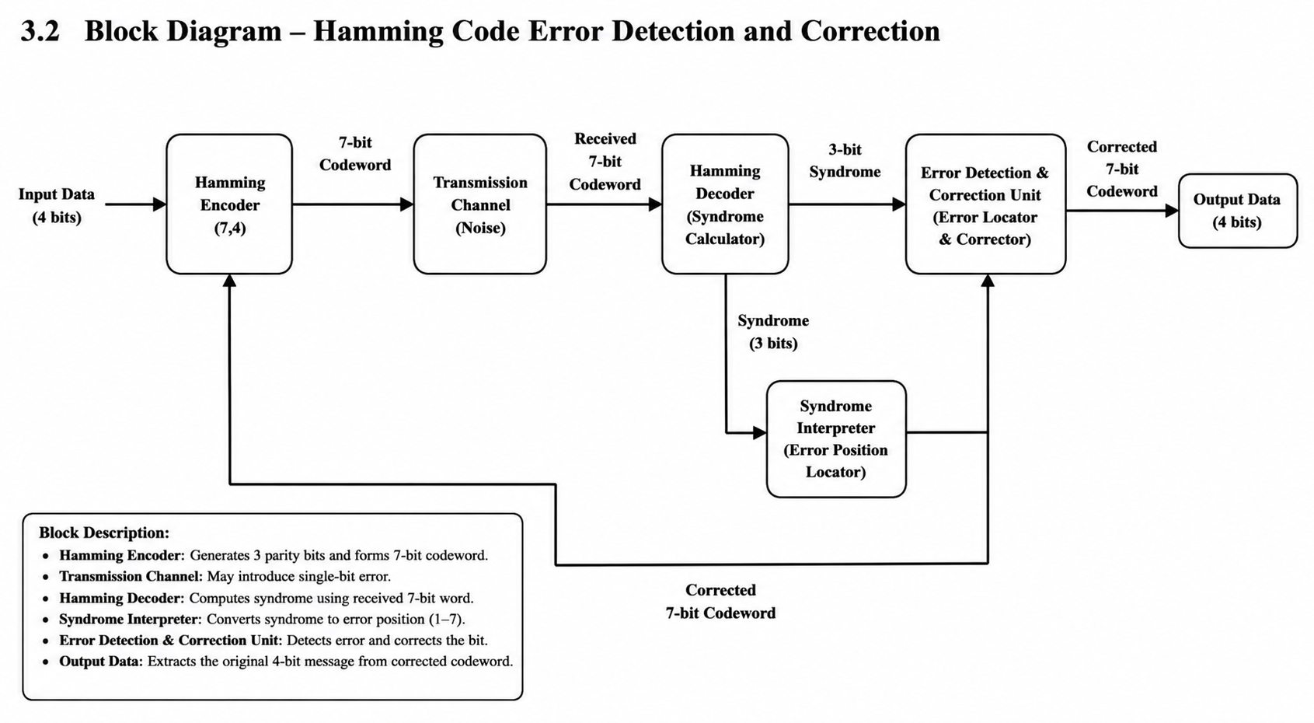

Slide 4
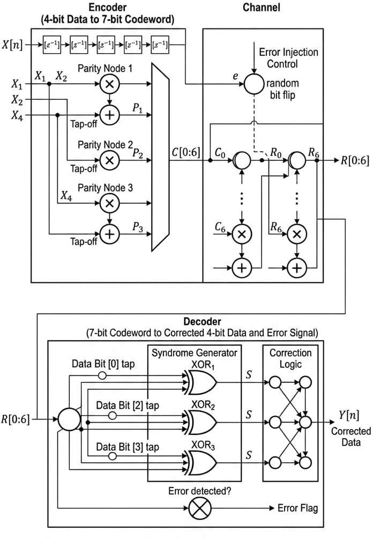
Architecture

Slide 5
https://github.com/meghraj-cpu/pbl/tree/docs

